Slide 1

Scripting Basics
Roger C. Dugan
Sr. Technical Executive, EPRI
Jacobs Hall, UCSD
Dec 14-15, 2010

Slide 2
Scripting
OpenDSS is a scriptable solution engine
Scripts
  Series of commands
  From text files
  From edit forms in OpenDSS.EXE
  From another program through COM interface
    e. g., This is how you would do looping
Scripts define circuits
Scripts control solution of circuits
Scripts specify output, etc.

Slide 3
Command Syntax
Command parm1, parm2 parm3 parm 4 ….
Parameters may be positional or named (tagged).
If named, an "=" sign is expected.
  Name=value (this is the named form)
  Value (value alone in positional form)
For example, the following two commands are equivalent:
  New Object="Line.First Line" Bus1=b1240 Bus2=32 LineCode=336ACSR, …
  New “Line.First Line”, b1240 32 336ACSR, …
Comma or white space

Slide 4
Delimiters
Array or string delimiter pairs: [ ] , { },( ),“ “,‘ ‘
Matrix row delimiter: |
Value delimiters: , (comma)
any white space (tab or space)
Class, Object, Bus, or Node delimiter: . (period)
Keyword / value separator: =
Continuation of previous line: ~ (More)
Comment line: //
In-line comment: !
Query a property: ?

Slide 5
Array and Matrix Parameters
Array
  kvs = [115, 6.6, 22]
  kvas=[20000 16000 16000]
Matrix
  (3x3 matrix)
    Xmatrix=[1.2 .3 .3 | .3 1.2 3 | .3 .3 1.2]
  (3x3 matrix – lower triangle)
    Xmatrix=[ 1.2 | .3 1.2 | .3 .3 1.2 ]

Slide 6
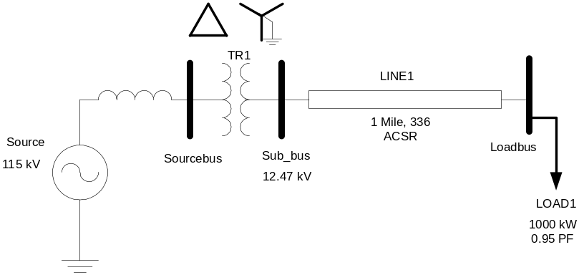
A Basic Script (Class Exercise)
New Circuit.Simple ! Creates voltage source (Vsource.Source)
Edit Vsource.Source BasekV=115 pu=1.05 ISC3=3000 ISC1=2500 !Define source V and Z
New Transformer.TR1 Buses=[SourceBus, Sub_Bus] Conns=[Delta Wye] kVs= [115 12.47]
~ kVAs=[20000 20000] XHL=10
New Linecode.336ACSR R1=0.058 X1=.1206 R0=.1784 X0=.4047 C1=3.4 C0=1.6 Units=kft
New Line.LINE1 Bus1=Sub_Bus Bus2=LoadBus Linecode=336ACSR Length=1 Units=Mi
New Load.LOAD1 Bus1=LoadBus kV=12.47 kW=1000 PF=.95
Solve
Show Voltages
Show Currents
Show Powers kVA elements

Slide 7
Circuit
New Circuit.Simple ! (Vsource.Source is active circuit element)
Edit Vsource.Source BasekV=115 pu=1.05 ISC3=3000 ISC1=2500
Vsource.Source
SourceBus
Source
115
kV
Short Circuit Impedance (a matrix) that yields 3000A 3-ph fault current and 2500A 1-ph fault current.
115 kV, 1.05 pu
One-Line Diagram
(default is 3-phase wye-grd source)

Slide 8
Vsource Element Note
Vsource is actually a Two-terminal Device
  2nd terminal defaults to connected to ground (0V)
  But you can connect it between any two buses
    Comes in handy sometimes
Conceptually a Thevinen equivalent
  Short circuit equivalent
  Actually converted to a Norton equivalent internally

Slide 9
20 MVA Substation Transformer
TR
SourceBus
1
Sub_Bus
Defining Using Arrays
Defining Winding by Winding
New Transformer.TR1 Phases=3 Windings=2
~ Buses=[SourceBus, Sub_Bus]
~ Conns=[Delta Wye]
~ kVs= [115 12.47]
~ kVAs=[20000 20000]
~ XHL=10
New Transformer.TR1 Phases=3 Windings=2 XHL=10
~ wdg=1 bus=SourceBus Conn=Delta kV=115 kVA=20000
~ wdg=2 bus= Sub_Bus Conn=wye kV=12.47 kVA=20000

Slide 10
The Line
Sub_Bus
LoadBus
LINE
1
1
Mile
,
336
New Linecode.336ACSR R1=0.058 X1=.1206 R0=.1784 X0=.4047 C1=3.4 C0=1.6 Units=kft
New Line.LINE1 Bus1=Sub_Bus Bus2=LoadBus Linecode=336ACSR Length=1 Units=Mi
Line objects may also be defined by Geometries and
using R, X, and C matrices

Slide 11
The Load
Loadbus
LOAD
1
1000
kW
0
.
95
PF
New Load.LOAD1 Bus1=LoadBus kV=12.47 kW=1000 PF=.95
For 3-phase loads, use L-L kV and total kW
For 1-phase loads, typically use L-N kV and total kW unless Delta-connected; Then use L-L kV.

Slide 12
Together…Shaping the Future of Electricity

